Slide 1
Search Engine Design – Group 27
Karen Kiernan, Dingkai Guo, Mengyu Li
8 minute presentation

Slide 2
Summary
What we did
Labelled sample of 3k records from Reuters21578 dataset with a 1-5 relevance score using ChatGPT
Compared BM25 vs BM25F ranking performance to ChatGPT gold standard for 10 queries
Tools used
NLTK to preprocess (remove stopwords, tokenise, lowercase)
Pyterrier for creating indexer and batch retrieval
Results
BM25F outperformed BM25 in relatively few cases
LLM relevance labelling efficient method to repurpose text classification datasets to IR
Further work
Experiment with word embeddings / query reformulations to track language drift in historic datasets (e.g. can ‘US president’ query return Reuters articles from 1987 featuring Donald Trump?)

Slide 3
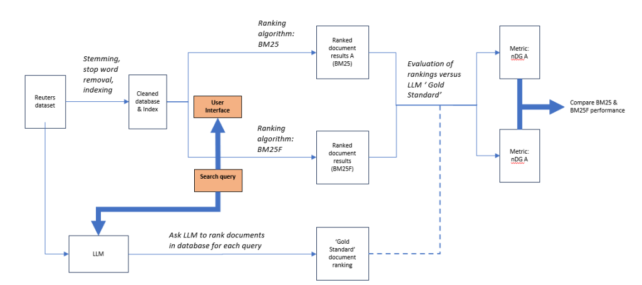
Pipeline
Metric: nDCG @ k
Metric: nDCG @ k

Slide 4
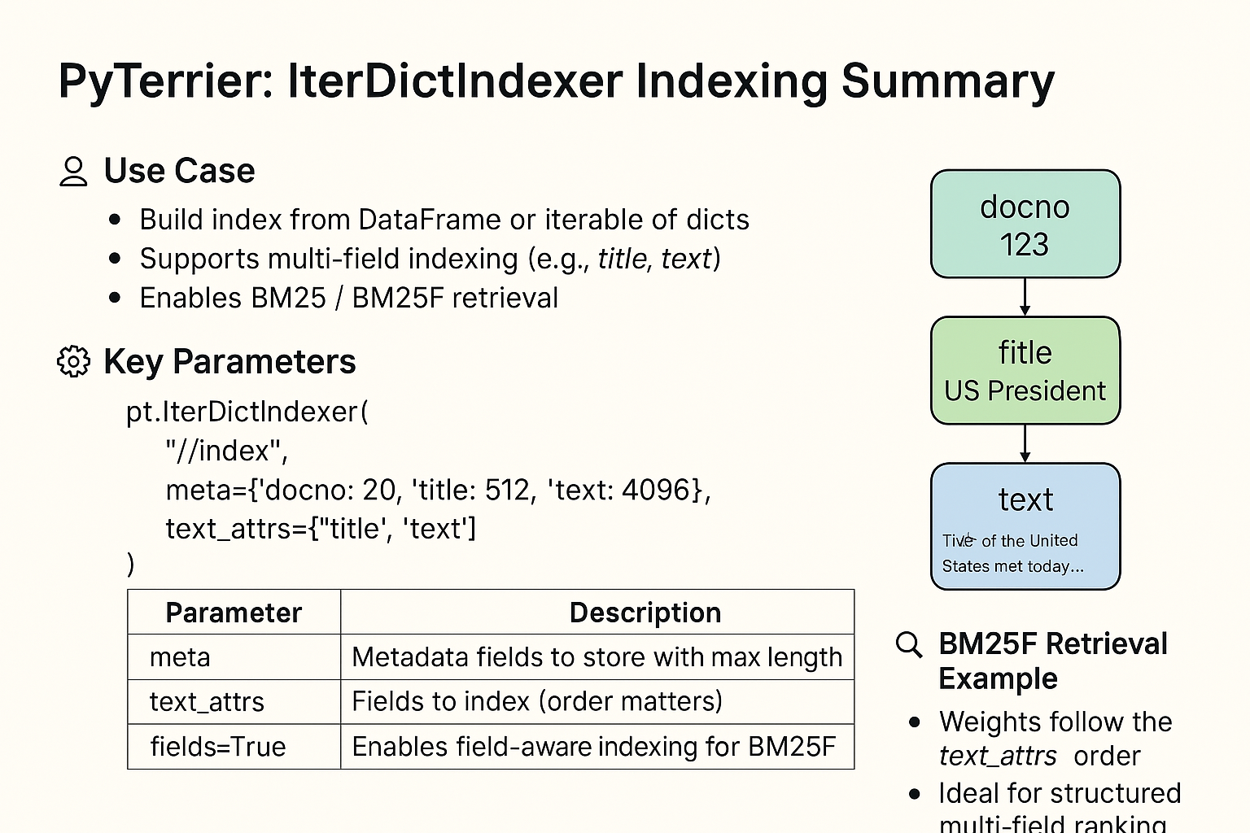
Indexing and retrieval

Slide 5
Demonstration

Slide 6
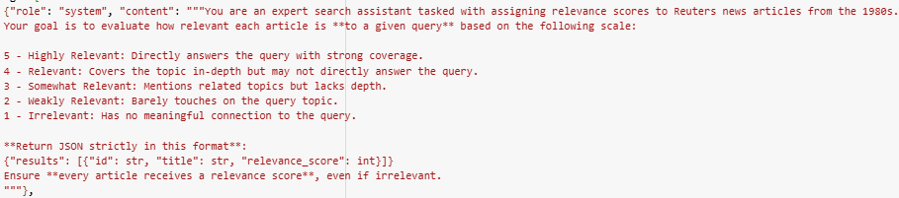
LLM relevance labelling
ChatGPT labelled database documents using following prompt:
Initial attempt at 1-100 score caused ChatGPT to provide incomplete results and buffering challenges
Range of 1-5 informed by Beyond Yes and No: Improving Zero-Shot LLM Rankers via Scoring Fine-Grained Relevance Labels, https://arxiv.org/abs/2310.14122

Slide 7
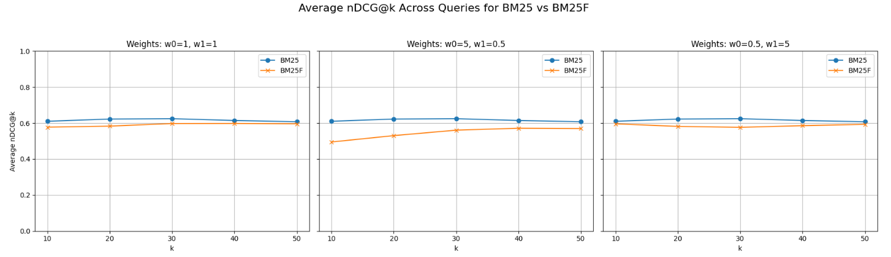
BM25 beats BM25F at all weightings
W0 = article ‘title’
W1 = article ‘text’

Slide 8

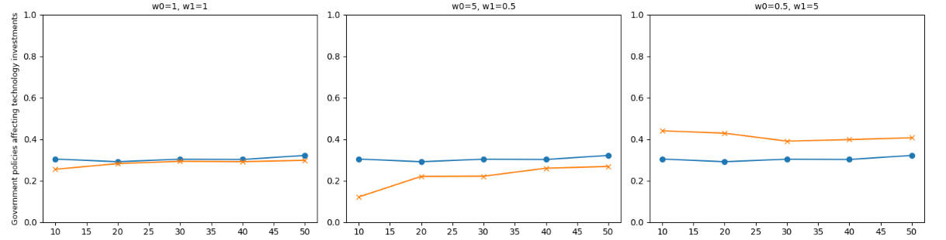
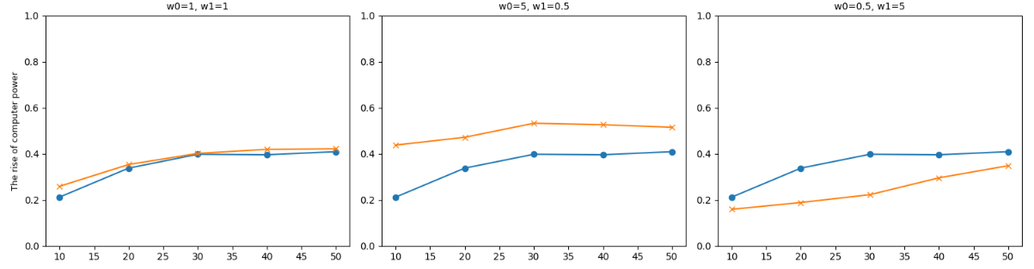
But it depends on the query…
‘Government policies affecting technology investments’
The general theme of this query suits a search weighted to article content. Therefore BM25F performs better when w0 < w1.
‘The rise of computer power’
Although this query is also thematic, several relevant articles had ‘computer’ in the title. Therefore, BM25F outperformed where w0 > w1.

Slide 9
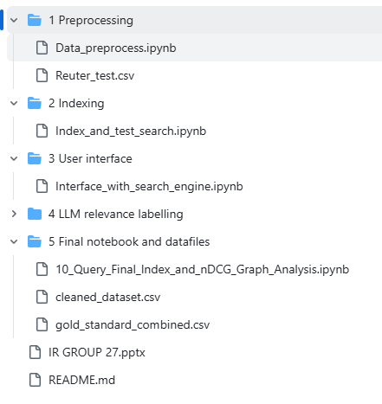
Github repository structure
https://github.com/Bob-623/Search-Engine/tree/main
Pre-processing code runs on Reuter_test.csv file
Indexer code (runs on cleaned_dataset.csv)
User interface code (runs on cleaned_dataset.csv)
LLM relevance labelled files per query
Consolidated notebook runs BM25 & BM25F across multiple queries and compares nDCG performance. Runs on:
BM25 & BM25F indexer runs on cleaned_dataset.csv
Consolidated relevance scores for all query article pairs

Slide 10
Thank you

